Slide 1
COMP 4300 Computer Architecture
Scoreboard: An Example
Part 1
Dr. Xiao Qin
Auburn University
http://www.eng.auburn.edu/~xqin
xqin@auburn.edu
Notes:
Lec13c: 50 min: slides 1-16
Lec14a: slides 17-36

Slide 2
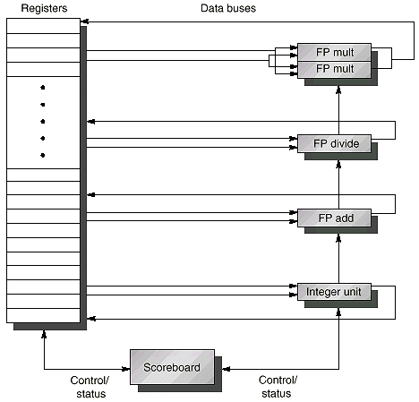
Review: Typical Scoreboard Structure
2 FP multiply, 1 FP adder, 1 FP divider, 1 integer

Slide 3
The Key idea of Dynamic Scheduling
Key Idea: Allow instructions behind stall to proceed. => Instructions executing in parallel. There are multiple execution units, so use them.
DIVD F0, F2, F4
ADDD F10, F0, F8
SUBD F12, F8, F14
  Enables out-of-order execution => out-of-order completion
ADDD stalls. Will SUBD stall?
Even though ADDD stalls, the
SUBD has no dependencies
and can run.
Dynamic pipeline scheduling overcomes the limitations of in-order pipelined execution by allowing out-of-order instruction execution.
Notes:
Mention two conditions: 1. operands are available, 2. No hardard

Slide 4
Using A Scoreboard: 4 stages
1. Issue —decode instructions & check for structural & WAW hazards (ID1)
  If a functional unit for the instruction is free (no structural hazards) and no other active instruction has the same destination register (no WAW), the scoreboard issues the instruction to the functional unit and updates its internal data structure.
  If a structural or WAW hazard exists, then
  the instruction issue stalls, and no further instructions will issue until these hazards are cleared.
2. Read operands —wait until no data hazards, then read operands (ID2)
  A source operand is available if no earlier issued active instruction is going to write it, or if the register containing the operand is being written by a currently active functional unit (no RAW).
  When the source operands are available, the scoreboard tells the functional unit to proceed to read the operands from the registers and begin execution. The scoreboard resolves RAW hazards dynamically in this step, and instructions may be sent into execution out of order.
Always
done in
program
order
Can be
done
out of
program
order
Notes:
Why issue in prog order

Slide 5
Using A Scoreboard: 4 stages (cont.)
3. Execution — operate on operands (EX)
  The functional unit begins execution upon receiving operands. When the result is ready, it notifies the scoreboard that it has completed execution.
4. Write result — finish execution (WB)
  Once the scoreboard is aware that the functional unit has completed execution, the scoreboard checks for WAR hazards. If none, it writes results. If WAR, then it stalls the instruction.
  Example:
  DIVD F0, F2, F4
  ADDD F10, F0, F8
  SUBD F8, F8, F14
  Scoreboard would stall SUBD until ADDD reads operands
No hazard
WAR hazard

Slide 6
Data Structure of A Scoreboard: Three parts
Instruction status—which of 4 steps the instruction is in
Functional unit status—Indicates the state of the functional unit (FU). 9 fields for each functional unit
Busy—Indicates whether the unit is busy or not
Op—Operation to perform in the unit (e.g., + or –)
Fi—Destination register
Fj, Fk—Source-register numbers
Qj, Qk—Functional units producing source registers Fj, Fk
Rj, Rk—Flags indicating when Fj, Fk are ready. Set to No after operands are read.
3. Register result status—Indicates which functional unit will write each register, if one exists. Blank when no pending instructions will write that register
Notes:
What you might have thought
1. 4 stages of instruction executino
2.Status of FU: Normal things to keep track of (RAW & structura for busyl):
Fi from instruction format of the mahine (Fi is dest)
Add unit can Add or Sub
Rj, Rk - status of registers (Yes means ready)
Qj,Qk - If a no in Rj, Rk, means waiting for a FU to write result; Qj, Qk means wihch FU waiting for it
3.Status of register result (WAW &WAR)s:
which FU is going to write into registers
Scoreboard on 6600 = size of FU
6.7, 6.8, 6.9, 6.12, 6.13, 6.16, 6.17
FU latencies: Add 2, Mult 10, Div 40 clocks

Slide 7
A Scoreboard Example
The following code is run on the MIPS with a scoreboard given earlier with:
    L.D F6, 34(R2)
    L.D F2, 45(R3)
    MUL.D F0, F2, F4
    SUB.D F8, F6, F2
    DIV.D F10, F0, F6
    ADD.D F6, F8, F2
Functional Unit (FU) # of FUs EX cycles
Integer 1 1
Floating Point Multiply 2 10
Floating Point add 1 2
Floating point Divide 1 40
All functional units
are not pipelined
(similar to CDC6600)
Real Data Dependence (RAW)
Anti-dependence (WAR)
Output Dependence (WAW)

Slide 8
Dependency Graph For Example Code
1
Example Code
L.D F6, 34 (R2)
1
2
3
4
5
6
L.D F6, 34(R2)
L.D F2, 45(R3)
MUL.D F0, F2, F4
SUB.D F8, F6, F2
DIV.D F10, F0, F6
ADD.D F6, F8, F2
2
L.D F2, 45 (R3)
3
MUL.D F0, F2, F4
Date Dependence:
(1, 4) (1, 5) (2, 3) (2, 4)
(2, 6) (3, 5) (4, 6)
Output Dependence:
(1, 6)
Anti-dependence:
(5, 6)
4
SUB.D F8, F6, F2
5
DIV.D F10, F0, F6
Real Data Dependence (RAW)
Anti-dependence (WAR)
Output Dependence (WAW)
6
ADD.D F6, F8, F2

Slide 9
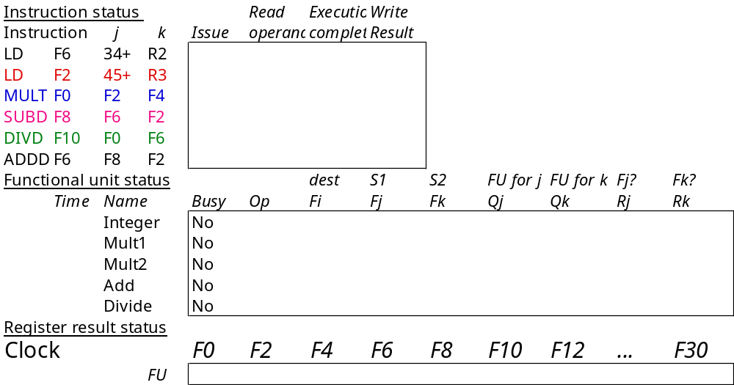
Scoreboard Example

Slide 10
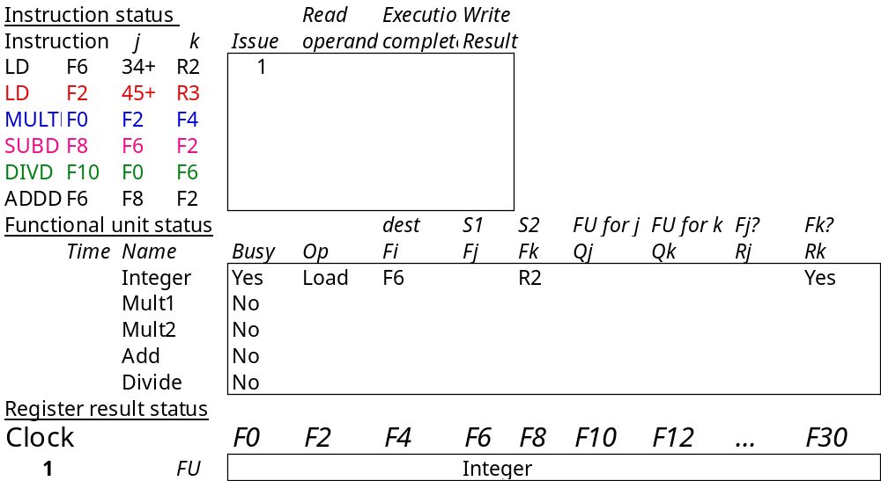
Scoreboard Example Cycle 1
Issue LD #1
Shows in which cycle the operation occurred.

Slide 11

Scoreboard Example Cycle 2
Can we issue LD #2?
integer unit is busy.
Can we issue MULT?
we require in-order issue.

Slide 12
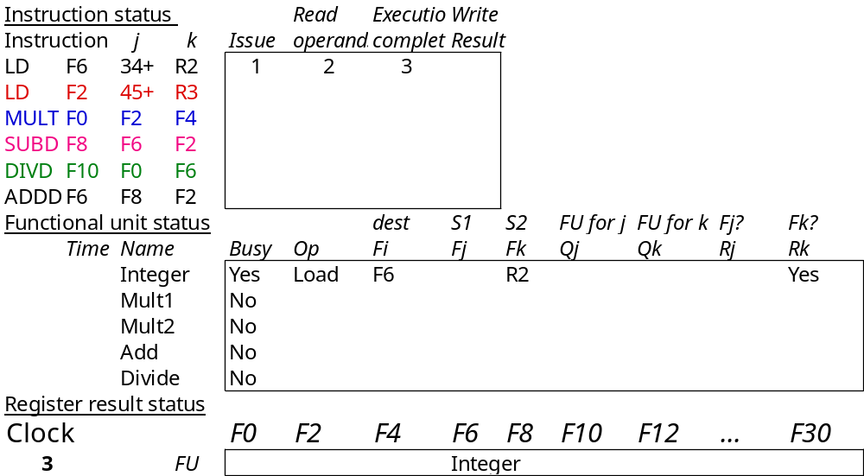
Scoreboard Example Cycle 3

Slide 13

Scoreboard Example Cycle 4
What happens next?

Slide 14
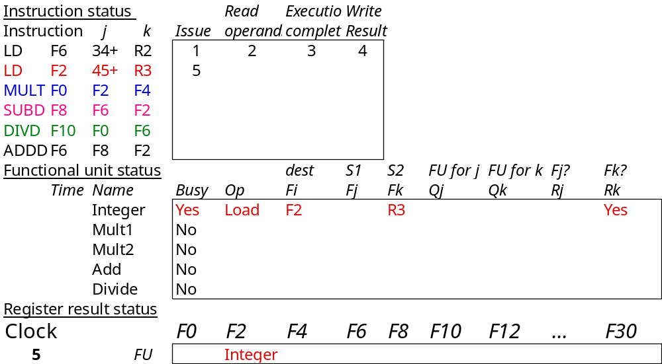
Scoreboard Example Cycle 5
Issue LD #2 since integer unit is now free.

Slide 15
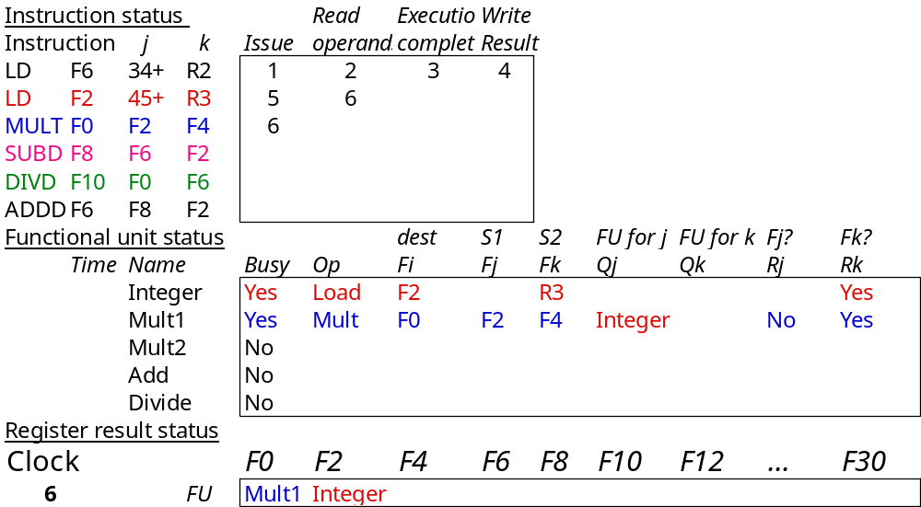
Scoreboard Example Cycle 6
Issue MULT.
Notes:
An error? F4

Slide 16
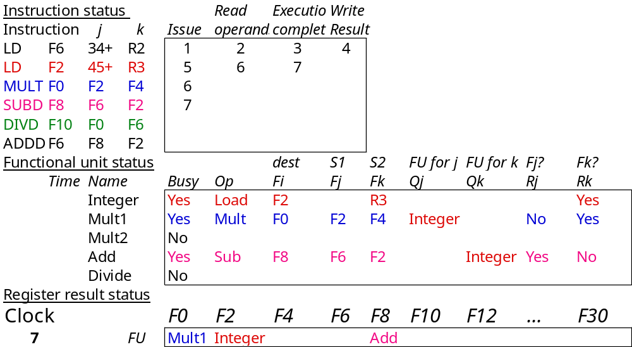
Scoreboard Example Cycle 7
Can MULT read its operands?
(F2) because LD #2 hasn’t finished.

Slide 17
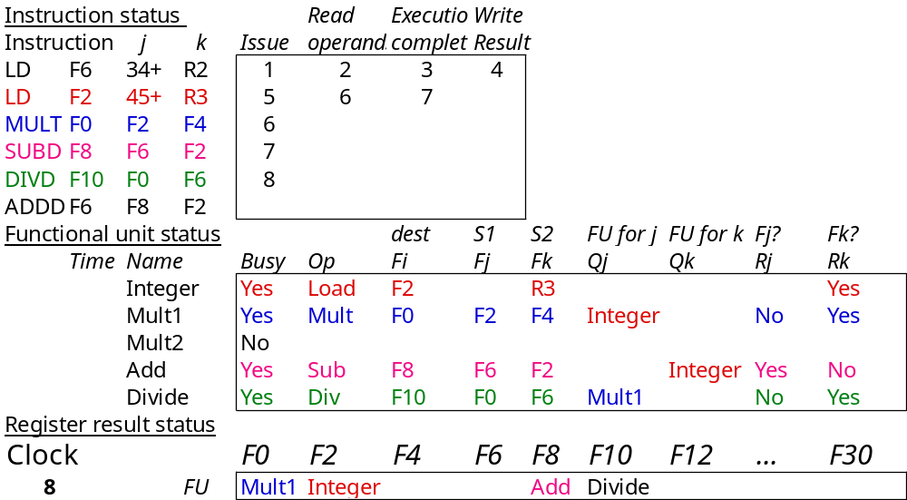
Scoreboard Example Cycle 8a
DIVD issues.
MULT and SUBD both waiting for F2.

Slide 18
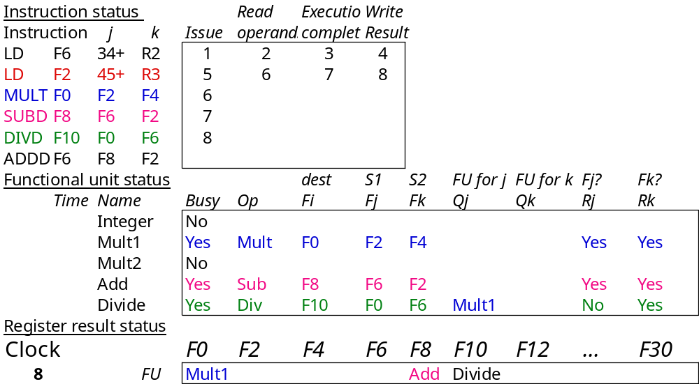
Scoreboard Example Cycle 8b
LD #2 writes F2.

Slide 19
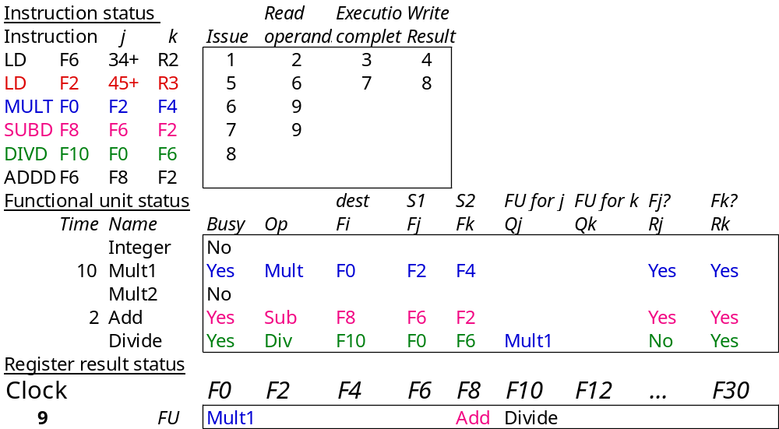
Scoreboard Example Cycle 9
Now MULT and SUBD can both read F2.
How can both instructions do this at the same time??

Slide 20
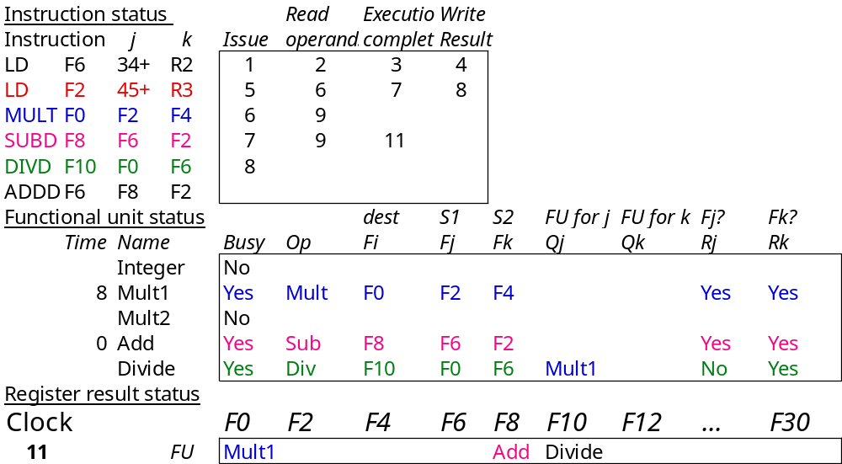
Scoreboard Example Cycle 11
ADDD can’t start because?
add unit is busy.

